Slide 1
DP Algorithm:
Subproblem/Decision/Base Case/Recursion
 | P1: Shortest Paths in DAGs
 | P2: Shortest Paths/Negative Edge Weights

Slide 2
Subproblem—Common Subproblems
No. | Input | How to write subproblem
Template1 | X from 1 to n( x[1:n] ) | A subproblem is x[1:i] Running time is n
Template2 | X from 1 to n( x[1:n] ) | A subproblem is x[i:j] Running time is n^2
Template3 | X from 1 to n( x[1:n] ) Y from 1 to m( y[1:m] ) | A subproblem is x[1:i] and y[1:j] Running time is mn

Slide 3
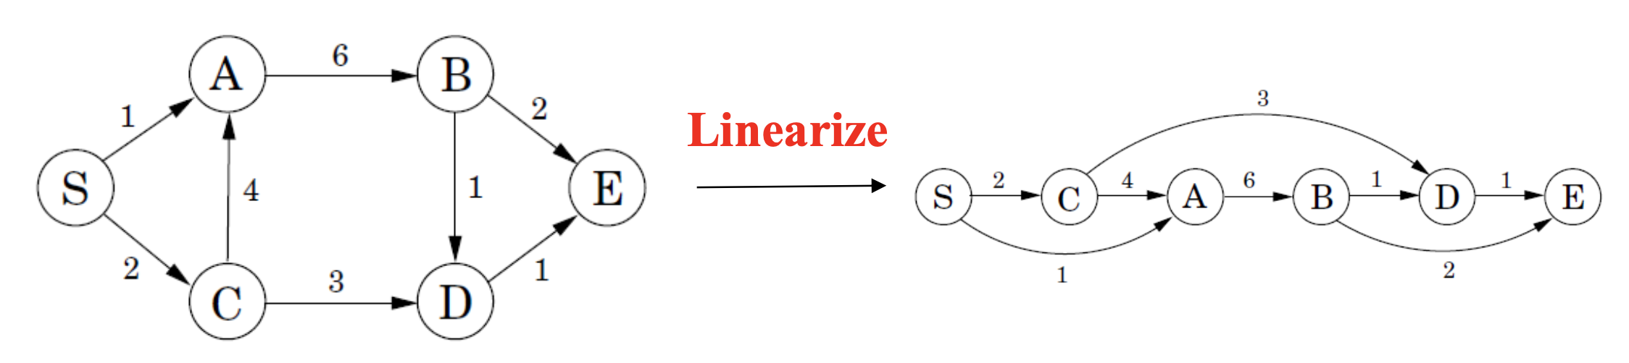
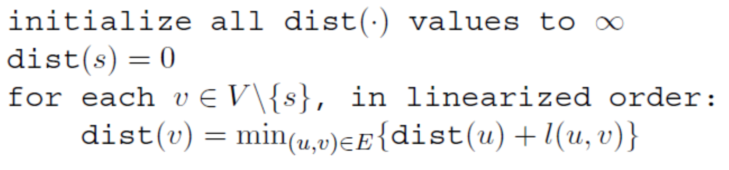
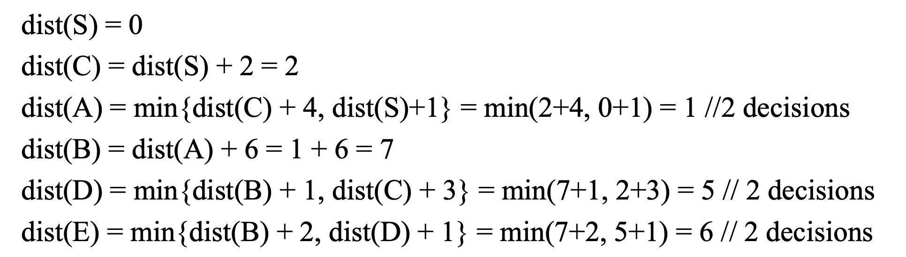
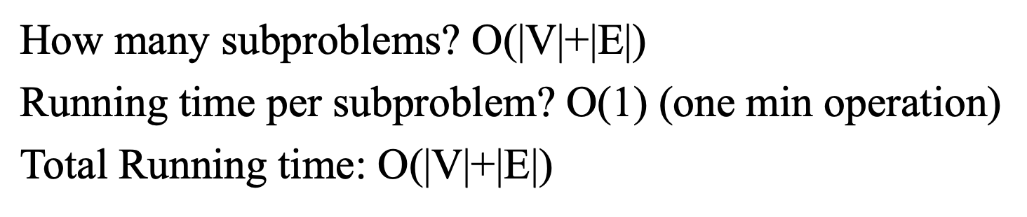
P1: Shortest Paths in DAGs—从一个点到所有点的最短距离
Topological
s/0 | c/1 | a/2 | b/1 | d/2 | e/2
 | c/0 | a/1 | b/1 | d/2 | e/2
 |  | a/0 | b/1 | d/1 | e/2
 |  |  | b/0 | d/1 | e/2
 |  |  |  | d/0 | e/1
 |  |  |  |  | e/0
前提条件：
It should be DAG and apply for topological method.
Subproblem | A subproblem is x[1:i] to calculate the shortest path.
Decision | Consider dist(v) to all parents of u and pick the min of dist(u) + l(u,v)
Base Case | dist(start) = 0 and dist(v) = infinite
Recursion | dist(v) = min{dist(u) + l(u,v) | for all (u,v) in linearized G}
Note:
V 源于dist初始化
E源于求最短的边

Slide 4
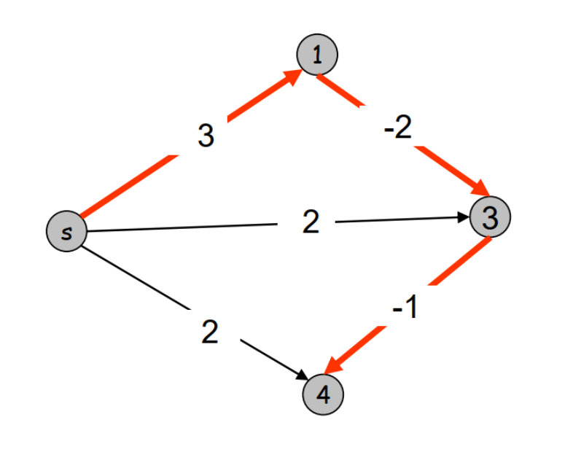
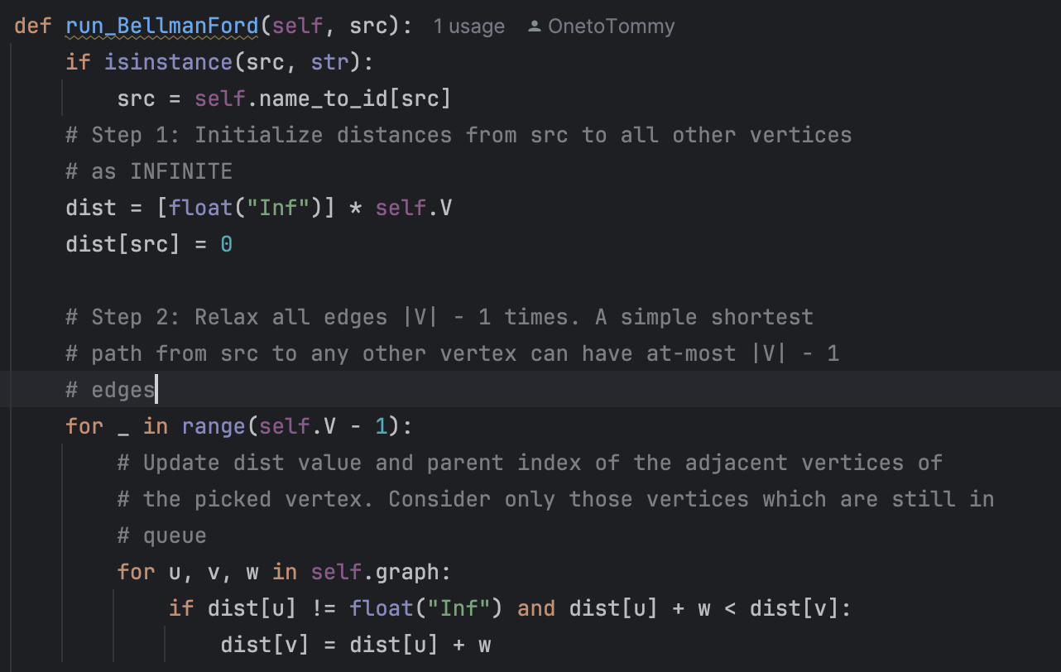
P2: Shortest Paths/Negative Edge Weights—Bellman Ford-template1
Can’t have negative cycles in Graph and analysis the Negative Cycle
 |  | Time
Subproblem | Let 𝑑(𝑣, 𝑖) be the length of the shortest 𝑠 −𝑣 path with at most 𝑖 edges | O(VE)
Decision | Case1:Not include edge i: 𝑑 (𝑣, 𝑖)= 𝑑(𝑣, 𝑖 − 1) Case2: Include edge I 𝑑 (𝑣, 𝑖) = 𝑑 (𝑣_{𝑖−1}, 𝑖 − 1) + weight
Base Case | 𝑑 (𝑣, 𝑖) = 0 if v = s; 𝑑 (𝑣, 𝑖) = inf if 𝑣 ≠ 𝑠, 𝑖 = 0
Recursion | 𝑑 (𝑣, 𝑖) = min(𝑑(𝑣, 𝑖 − 1), 𝑑 (𝑣_{𝑖−1}, 𝑖 − 1) + weight )
Edge | S | 1 | 3 | 4
0 | 0 | inf | inf | inf
1 | 0 | 3/s | 2/s | 2/s
2 | 0 | 3/s | 1/1 | 2/s
3 | 0 | 3/s | 1/1 | 0/3
Note:
需要Get i = n-1的思维，因为它假设每个点有n-1条边，从而确定最小距离；
Decision也是有这点决定的：
如果不适用i条边数值，让最短距离等于i-1
如果使用i条边数值，需要将一条边最小距离与i-1比较，得出最小距离。

Slide 5
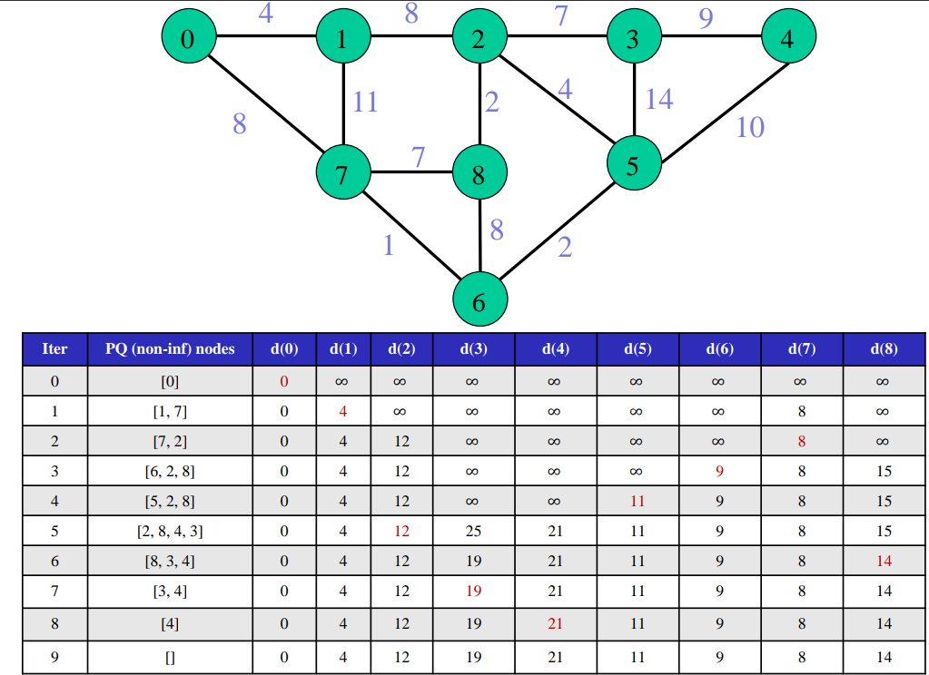
Dijkstra—一个点到所有点最短距离，能够处理都是正数的环，负数不可以
 | Step | Code: s-start node; l- edge weight | time
 | PQ | Dij(G, s, l): Initialize PQ
 | Define infinite for all vertex | For v in V dist(v) == infinite Q.insert(v) dist(s) = 0 | V
 | Find the shortest path | While Q not empty: v = Q.pop() For (v, w) in G: If dist(v) + l(v,w) < dist(w): dist(w) = dist(v) + l(v,w) Q.append(w) | V+E

Slide 6
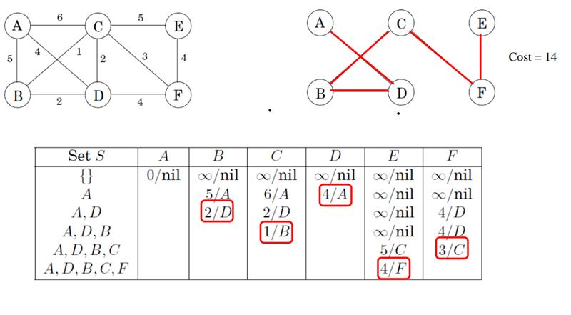
Prim—所有点连接的最短距离
 | Step | Code: s-start node; l- edge weight | time
 | 初始化将所有点为无穷大 | Prim(G, w): For v in V: cost(v) = infinite Prev(v) = nil pick any initial node as u cost(u) = 0 PQ.append(u) While PQ: v = PQ.pop() For each {u, z} in G[v]: If cost[z] > w(u,z) cost[z] = w(u,z) Prev(z) = u PQ.append(z) | 红色字体： VlogV
 | 任意选择一个点作为起点
 | 运用PQ逻辑每次对相邻最小的进行弹出
 | 将新发现的最小边的点加到PQ |  | 蓝色字体： ElogE

Slide 7
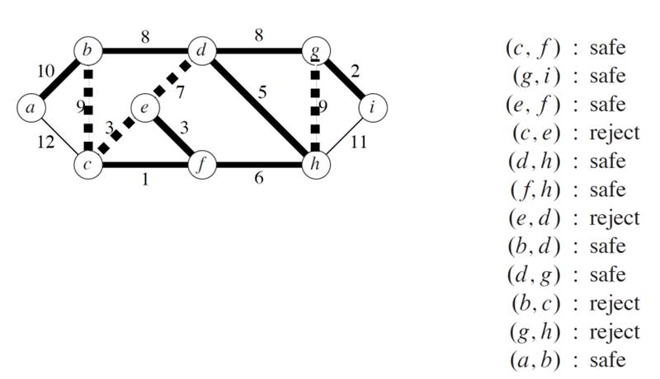
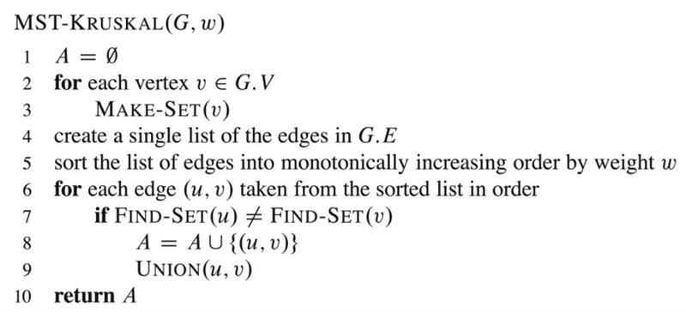
Kruskal—所有点连接的最短距离
 | Step | Code: s-start node; l- edge weight | time
 | 提取每个边的权重，然后增加到PQ |  | 第一部分时间复杂度最高为 ElogE
 | 从最小权重开始Loop
 | Union Find判断它们是否相同
 | 如果不相同将它们添加 |  | 第二部分就是边的比较 E

